Slide 1
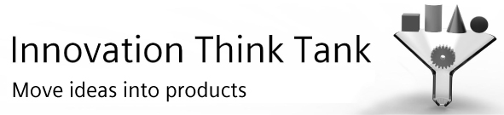

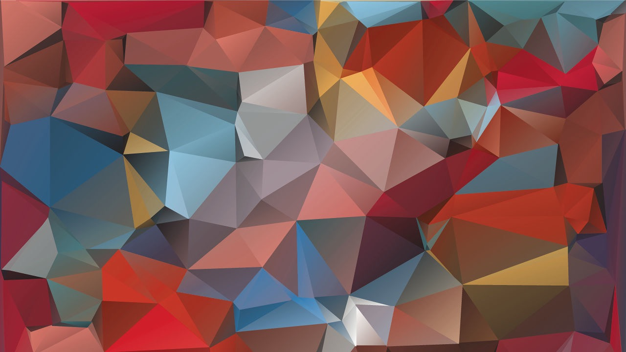
Team
3
Sandal Kotawala
B Tech [II year]
Electrical Engineering
VIT University, vellore
Akarsh Goyal
B Tech [III year]
Computer Science Engineering
VIT University, vellore
Amartya Sarkar
B Tech [III year]
Computer Science Engineering
VIT University, vellore
1
2
3

Slide 2
Team 3
Challenges in Indian Healthcare System

Slide 3
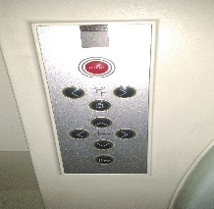
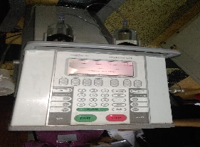
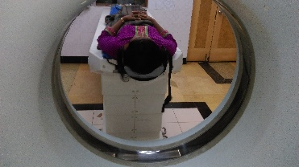
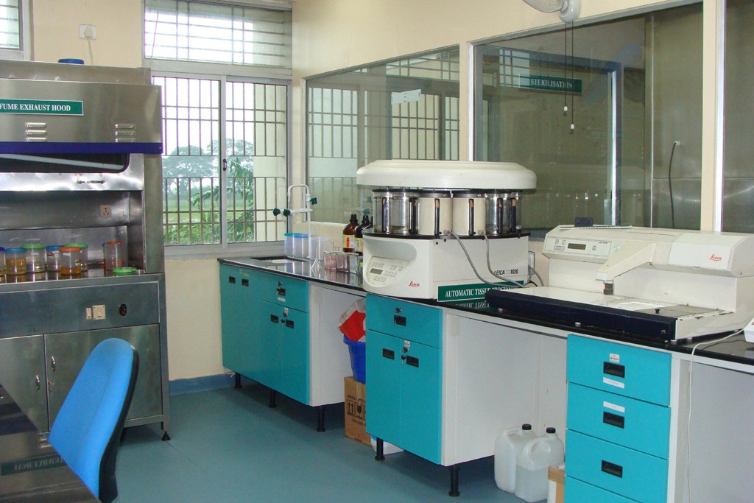
Team 3
Observations in the Goa Scan center
CT-SCAN
Computer System- Three systems were being used for controlling and processing the scan process. They were a computer, remote control CT2 and a device with keypad. On the computer the work is saved on a database known as Medpc. First the patient registration is done there. Topogram view was taken. The guy handling this was taking an axial slice. The white part in the image was for bone and cavities. Different views of the scan were taken. The white part was cut-off manually to remove those things which are non-contributing to the scan. For properly seeing the contrast black and white imagery is there. It was being done for angio so the white part was cut. The spin and the tilt of the view are also displayed on the view screen. An option was also given in the software to input radial ranges. The inputs to be given were angle between images and the number of images.
CT-Scan Machine- The CT-Scan machine’s name was Somatom Sensation and it was made by Siemens. The machine has a lever type system to make it go up and down. A thermometer was there in the room to keep the room temperature under check. A temperature of 18C was maintained and it does not change. One problem was that the machine was kept continuously on at all times during the day after starting it once in the morning even when it only takes 5 minutes to start the machine. So it could be kept off when there are no patients for a 1 or 2 hours.
Use of Contrast- The procedure is first started by doing plain scan. Then the report is shown to the doctor. If the doctor feels that more discernment should be there then contrast is done where the fluid is either injected or orally taken by the patient. Contrast is administered for the patient which depends on his height and weight. Contrast is done by taking a fluid which has barium and it highlights those parts which needs to be scanned. Contrast has higher atomic number as compared to other fluids and parts in the body. So they are able to easily make places which need scanning denser Oral Contrast is performed for people with sinus problem and those with bladder or pelvic problem have contrast intravenously injected into them.
Some of the problems encountered by them were-
If while starting the contrast stage if the process gets stuck due to problems given by the generator then the whole procedure needs to be repeated.
Some post-scan problems were difficulty given by system due to its technical fault which is treated by engineers sent by Siemens, Logon etc
Some of the areas where I found some good solutions could be developed were-
Tilt- A person with leg problem was not given the facility which could help him to lift his leg while scanning.
Pregnant Woman is not allowed to get the CT-Scan done.
Manually removing bone and cavity area is very tedious and it could be done by using other things
.
MRI
The computer system had these readings:
Slab Group Fov read
Slabs Fov phase
Dist. Factor Thickness
Position TR
Orientation TE
Phase enc. dir. Averages
Autoassign Concatenations
Phase Oversampling Filter
Slice Oversampling Coll elements
The screen also displayed breathing ECG reading. Breathing patterns were being recorded.
The time needed to take MRI is 4 mins. 4-5 sequences of no breathing were being performed and communicated by the lab person to the patient so that much more clear images of the scan could be obtained. If the patient is somewhat uncooperative then he is sedated so that he doesn’t move and cause problems during scanning.
The temperature to be maintained inside the room was 19C. If the temperature is not properly maintained then:
Helium level in the system can go down
Images taken will be blurry.
Helium level should be 70. It is replaced once during a year.
If any critical problem develops during the process then emergency stop button has also been provided to immediately stop the whole the entire machine.
Fluroscopy function was not present in the system.
Problems-
MRI could not be performed on people who are fat. So it is a problem.
Metal objects are not allowed in the MRI Room as it will affect the magnetic function of MRI.
P- Scanning has to be started again if the patient is breathing abnormally.
PATHOLOGY LAB
Mindray-The machine used to do Haemotology. It gave the Haemoglobin count, WBC,RBC and platelets count.ESR detected if the person has an infection or not by inserting the sample in it. Then two devices to test were there. One was semi-automated and the other one was fully-automated. The semi-automated device was used to perform tests like liver function test and kidney test. The name of the fully-automated device was HB1C. All kinds of tests could be checked by it. It can take 40 sample tests in total and out of it 15 tests could be that of a single person. Reagents were kept in it. The sample quantity should be 2-3 ml. Any probe problem is detected by seeing the graph by the lab doctors. MYSPA I2 was the device shown to us which took the glycogel joint test and gave the result in 5 mins.
Prothomin Tam -The device which is used to get the clotting time.
Electropath Platolyte 3-The device which takes a sample consisting of diet and serum.
A centrifuge device was there named REMIR-8C. It performs centrifugation for separating the layers of serum,RBC,WBC etc.
Problems- No proper waste disposal system.
If Fully automated system gives some anomalous reading then test is performed again on semi-automated.
ULTRASOUND
The ultrasound of only heart was shown to us for 2 minutes. Blue denoted blood going down from the heart and red lines denoted blood going up from heart. The four chambers of the heart were properly shown. Blood of the four chambers shouldn’t mix otherwise it could be critical problem for a person. If a person has a hole in the heart then the above mentioned thing happens which could pose a serious threat to his life..

Slide 4
Team 3
Observations in the Goa Scan centre
Radiology
Pathology
Emergency workflow
General

Slide 5
Team 3
Observations in the Goa Medical Centre
Radiology
Pathology
Emergency workflow
General

Slide 6
Team 3
Proposed ideas overall
Related to radiology-
Disturbances are caused in radiology due to breathing, tattoos, internal metal screw [IRREGULAR BREATHING = DO AGAIN] Blurred Images, ECG must be behind yellow line. So Automatic peak detection should be there in ECG to prevent false reading at early step .
MRI is not possible for fat people. To overcome the problem wide bore MRI machine should be used in which diameter can be increased, longer needles and steadier beds.
Helium level goes down if temp [15-20 degree centigrade ] is not maintained. Continuously filled cryostat could be used which consumes a negligible amount of liquid helium. It can measure temperatures below 4.2K to room temperature and also control the pressure of the exchange gas in the vacuum.
Communication problem for breathing between operator and patient [language barrier] care taker has to stand during radiology. Robot type technology could be used in the machine to stop the breathing of the patient for the required time.
Patients experience discomfort when they are transferred from one bed to other for tests. Bed with wheels for CT scan for easy patient transfer.
Metal objects are not allowed inside the MRI room. Using metal detector gate before undergoing MRI the metal objects could be detected.
Operating C-Arm again and again manually is a problem . Voice/ Joystick based C arm operation could be done and sensors in C arm could be used to prevent collision.
CT scan of leg of an injured person is a problem for him. Facility can be provided where the patient doesn't have to lift his leg.
CT scan is dangerous for pregnant ladies. Shield could be used.CAT scans use 360 degrees of radiation…if only chest scan is to be performed a shield placed beneath back low around abdominal area..and a sheild placed over abdomen.
Manual selection of bone and cavity area is very time-consuming. Software such as photoshop could be used for automatically detecting white areas. Machine learning could be used to feed the system with different pictures of bones and cavities and it could be matched with incoming view.
If patient is sedated breathing cant be regulated. Much finer modules could be used for taking image sequences when person is sedated.
Unnecessary exposure by C arm during positioning at proper position. Using laser in C arm proper position of part to be scanned could be known. Also the machine should be able to detect area to be scanned.
The radiation details should be highlighted on machine for patients to know and get comfortable with. Also dosiametricians should properly explain the amount of radiation which will affect them during radiation.
Related to pathology-
When test in bioanalyzer is done, machine does not self detect the anomalous readings, lab assistant has to manually see graphs. . Machine learning could be used which does auto- analysis.
Sample must be tested in least time possible. So conveyor mechanism to transfer sample to prevent sample quality loss.
Sample are not marked properly and lost. Test tubes could be barcoded in which the sample is taken.
The lab areas are also infected with contagious diseases and infections. These areas should follow proper sanitization policy and also these places should be continuosly probed for different microbes present even in the air.
General-
Often doctor and patient are not in complete contact with each other . So it could cause problems. App notifications for medication, video conferencing, etc could be put in place to overcome it.
Improper waste disposal in hospitals is there. Incineration could be used. Autoclave is also an efficient method. Bleach , heat , alkaline digesters could be used to disinfect biomedical waste.
Electricity generator is not available for sufficient time. Some source for storing the energy at other times could be used which would power the AC when power issues are there.
Distant care taking of patients using sensor and video chat. [Rural area].

Slide 7
Team 3
Proposed ideas overall
General (Cont)-
Recording surgeries based on R pi for training purposes.
Pi based cell micro organism counter .
MRI machine and CT machine is always kept on, kinetic energy is wasted. A battery with capacitor could be used for storing the kinetic energy into potential energy that could be put to other use later.
People do not recognise where to go, lack of interpretable signages. Use colour coded department and room signages, make hospital more friendly and lively.Use RFID based smart traffic management.Language independent signages .
People have to wait a lot in queue. Provide direct registration on app which could be done by the patient anywhere.
Many invasive tests, requiring pricking causing wounds and pain. Sensor based non-envasive techniques could be used.
Segregating and recycling biomedical waste : recycling plastic and using ash as manure.
Keeping pace with new drug launches and placing orders accordingly. Registering with such suppliers through some online system who directly update the new drugs which they get.
People have many cultural differences due to which they don’t undergo some operations. People should be taught about efficient methods which may not lie in there cultural boundaries but can help in saving their lives.
Attaching camera on drill machine for one drilling.
No effective and simple insurance policy for Indian patients is there at the moment. Good insurance policies should be made which profit both the patient and the company providing the policy.
To get training for instruments a person proficient in this or an engineer needs to come. Surgery Video and virtual training using VR for machine use could be used instead.
Hospitals often do not use complete machine functionality. People could be taught to use these functionalities safely and effectively.
Hospital Independent ambulance and ambulance goes to nearest hospital ; get patient information through GPS of mobile in case of any casualty. Also preparation in advance could be done before emergency as per notification from ambulance .
Many women have misconception that mammography procedure is quite painful which is not infact. So awareness app for women could be made.
Using Play station to measure improvement in hand movement [gesture detection] .
Digitising hospital: barcodes, digital records, RFID .

Slide 8
Team 3
Implementation proposal/ concept 1
Implementation proposal /Concept 2

Slide 9
Team 3
Implementation proposal/ concept 3
Implementation proposal /Concept 4

Slide 10
Team 3
Implementation proposal/ concept 5
Implementation proposal /Concept 6

Slide 11
Team 3
Implementation proposal/ concept 7
Implementation proposal /Concept 8

Slide 12
Team 3
Implementation proposal/ concept 9
Implementation proposal /Concept 10

Slide 13
participants
Proposed ideas overall
Examples /Hints
Hospitals of the future
Fully automated beds for patient transport
Convertible patient tables / chairs
Power supply for the mobile equipments
Drones for transporting medications, components, blood samples etc.
Radiology of the future
OR of the future
Diagnostic workflow of the future
Easy to use user interfaces
Patient treatment of the future
Various kinds of APPs for improving the healthcare systems / patient treatment

Slide 14
Team 3
Challenges in Indian Healthcare System

Slide 15
Participants names and institution
Observations in the Apollo Victor hospital
150 Bed hospital , occupancy 35-40 bed. [10 years old]
Radiology instruments available : CT Scan, MRI, Ultrasound, Mammography, portable Xray, Cath

